Slide 1

Adventure Works Business Intelligence & Sales Analytics
End-to-End Data Analytics Project using MySQL, Excel, Power BI & Tableau
ExcelR

Slide 2

Presented By
Project: P1345 – Adventure Works
Technologies Used
🗄 MySQL
📊 Microsoft Excel
📈 Power BI
📉 Tableau
Kailash , Pratyusha,
Swati , Manan,
Sahil, Priya

Slide 3
Company Overview
About Adventure Works
Adventure Works Cycles is a multinational bicycle manufacturing company that sells products across North America, Europe, and Asia. The company manufactures bicycles and related accessories and maintains a large sales database for business analysis. The project scenario focuses on using historical sales data to support better business decisions.
Business Environment
Manufacturing Industry
Global Operations
Multiple Product Categories
Multiple Sales Territories
Large Customer Base
Historical Sales Data
Objectives
✔ Improve Sales Performance
✔ Improve Profitability
✔ Identify Best Customers
✔ Analyse Product Performance
✔ Improve Regional Sales

Slide 4
Business Challenges
Adventure Works wants to answer several key business questions:
Sales
How are sales performing over time?
Profit
Which products generate maximum profit?
Customers
Who are the most valuable customers?
Products
Which products contribute most to revenue?
Geography
Which countries and regions perform best?

Slide 5
Project Objectives
Develop an end-to-end Business Intelligence solution for Adventure Works.
Specific Objectives
✔ Design a relational database
✔ Import and clean data
✔ Build Star Schema
✔ Perform SQL Analysis
✔ Create KPIs
✔ Build Interactive Dashboards
✔ Generate Business Insights
✔ Support Decision Making
Deliverables
MySQL Database
Excel Dashboard
Power BI Dashboards
Tableau Dashboard
Business Report
Presentation

Slide 6
Project Architecture
End-to-End Analytics Workflow
Adventure Works Dataset
│
▼
MySQL Database
(Storage & SQL Analysis)
│
▼
Microsoft Excel
(Cleaning, KPIs & Dashboard)
│
▼
Power BI
(Data Model, DAX & Dashboards)
│
▼
Tableau
(Interactive Visual Analytics)
│
▼
Business Insights &
Executive Decision Making
Why this Architecture?
✔ Scalable
✔ Organized
✔ Easy to Maintain
✔ Industry Standard

Slide 7
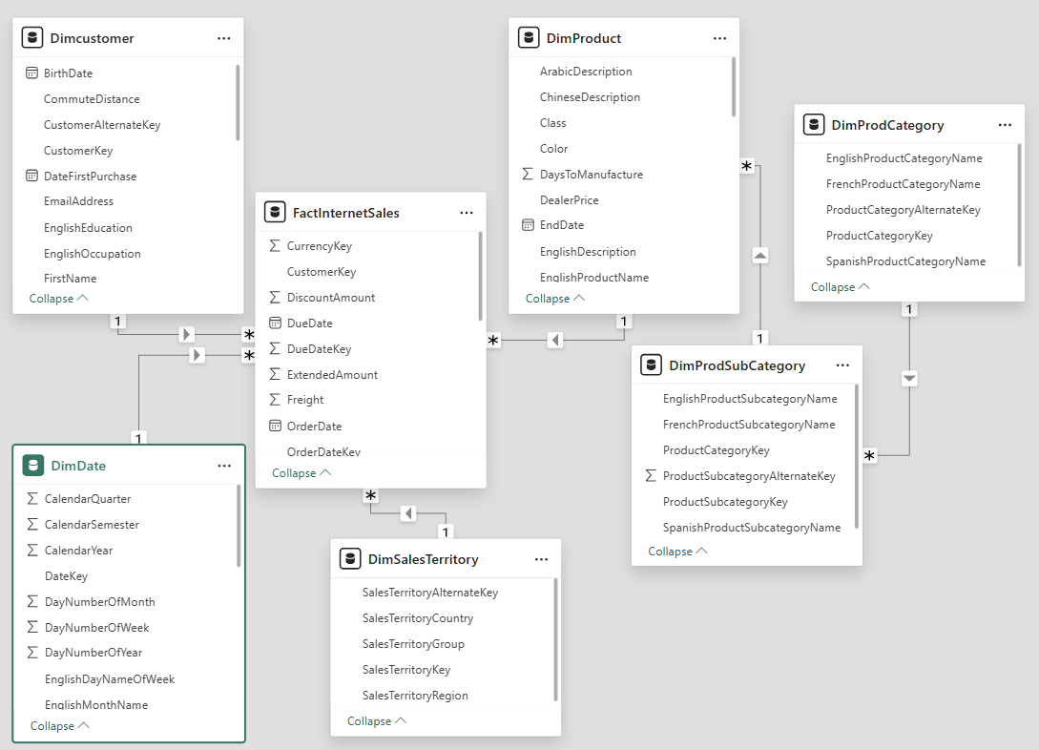
Data Model (Star Schema)
This project uses a star schema centred on the FactInternetSales table with dimension tables for Customer, Date, Product, and Sales Territory, as described in the project document.
Benefits
✔ Faster Reporting
✔ Better Query Performance
✔ Easy Data Analysis
✔ Optimized Dashboard Performance

Slide 8
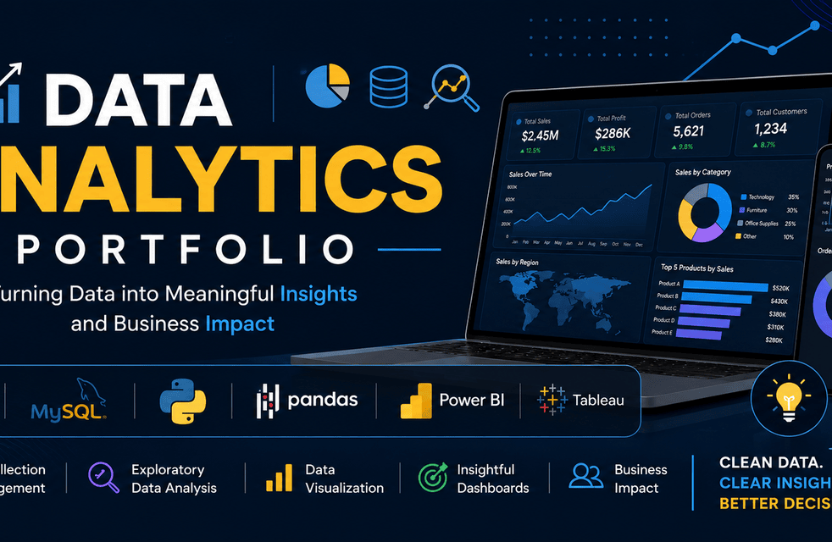
MySQL Database Implementation

Slide 9
MySQL Database Design & Data Preparation
Adventure Works Raw Data
CSV / Excel Files
│
▼
MySQL Database
DimCustomer DimProduct DimDate DimSalesTerritory
│
▼
FactInternetSales
│
▼
SQL Queries & Analysis
│
▼
Clean Analytical Dataset
│
▼
Power BI & Tableau Dashboards
Objective
Build a structured relational database to efficiently store, manage, and prepare Adventure Works sales data for Business Intelligence reporting.
Technologies
MySQL Workbench
SQL
Relational Database
Star Schema

Slide 10
Database Schema
Database Structure
Table | Type | Purpose
FactInternetSales | Fact Table | Stores sales transactions
DimCustomer | Dimension | Customer details
DimProduct | Dimension | Product information
DimDate | Dimension | Date hierarchy
DimSalesTerritory | Dimension | Geographic information
DimProductCategory | Dimension | Product categories
DimProductSubCategory | Dimension | Product subcategories
Why Star Schema?
✔ Faster reporting
✔ Optimized SQL queries
✔ Easy dashboard integration
✔ Industry-standard BI architecture

Slide 11
SQL Queries & Data Preparation
SQL Operations Performed
Data Import
Imported CSV files into MySQL
Verified data integrity
Created primary and foreign keys
Data Processing
INNER JOIN
LEFT JOIN
GROUP BY
ORDER BY
Aggregate Functions
SQL Functions Used
SUM()
COUNT()
AVG()
ROUND()
CASE
STR_TO_DATE()
Business Queries
Total Sales
Total Profit
Sales by Country
Top Customers
Top Products
Monthly Sales
Category Performance

Slide 12
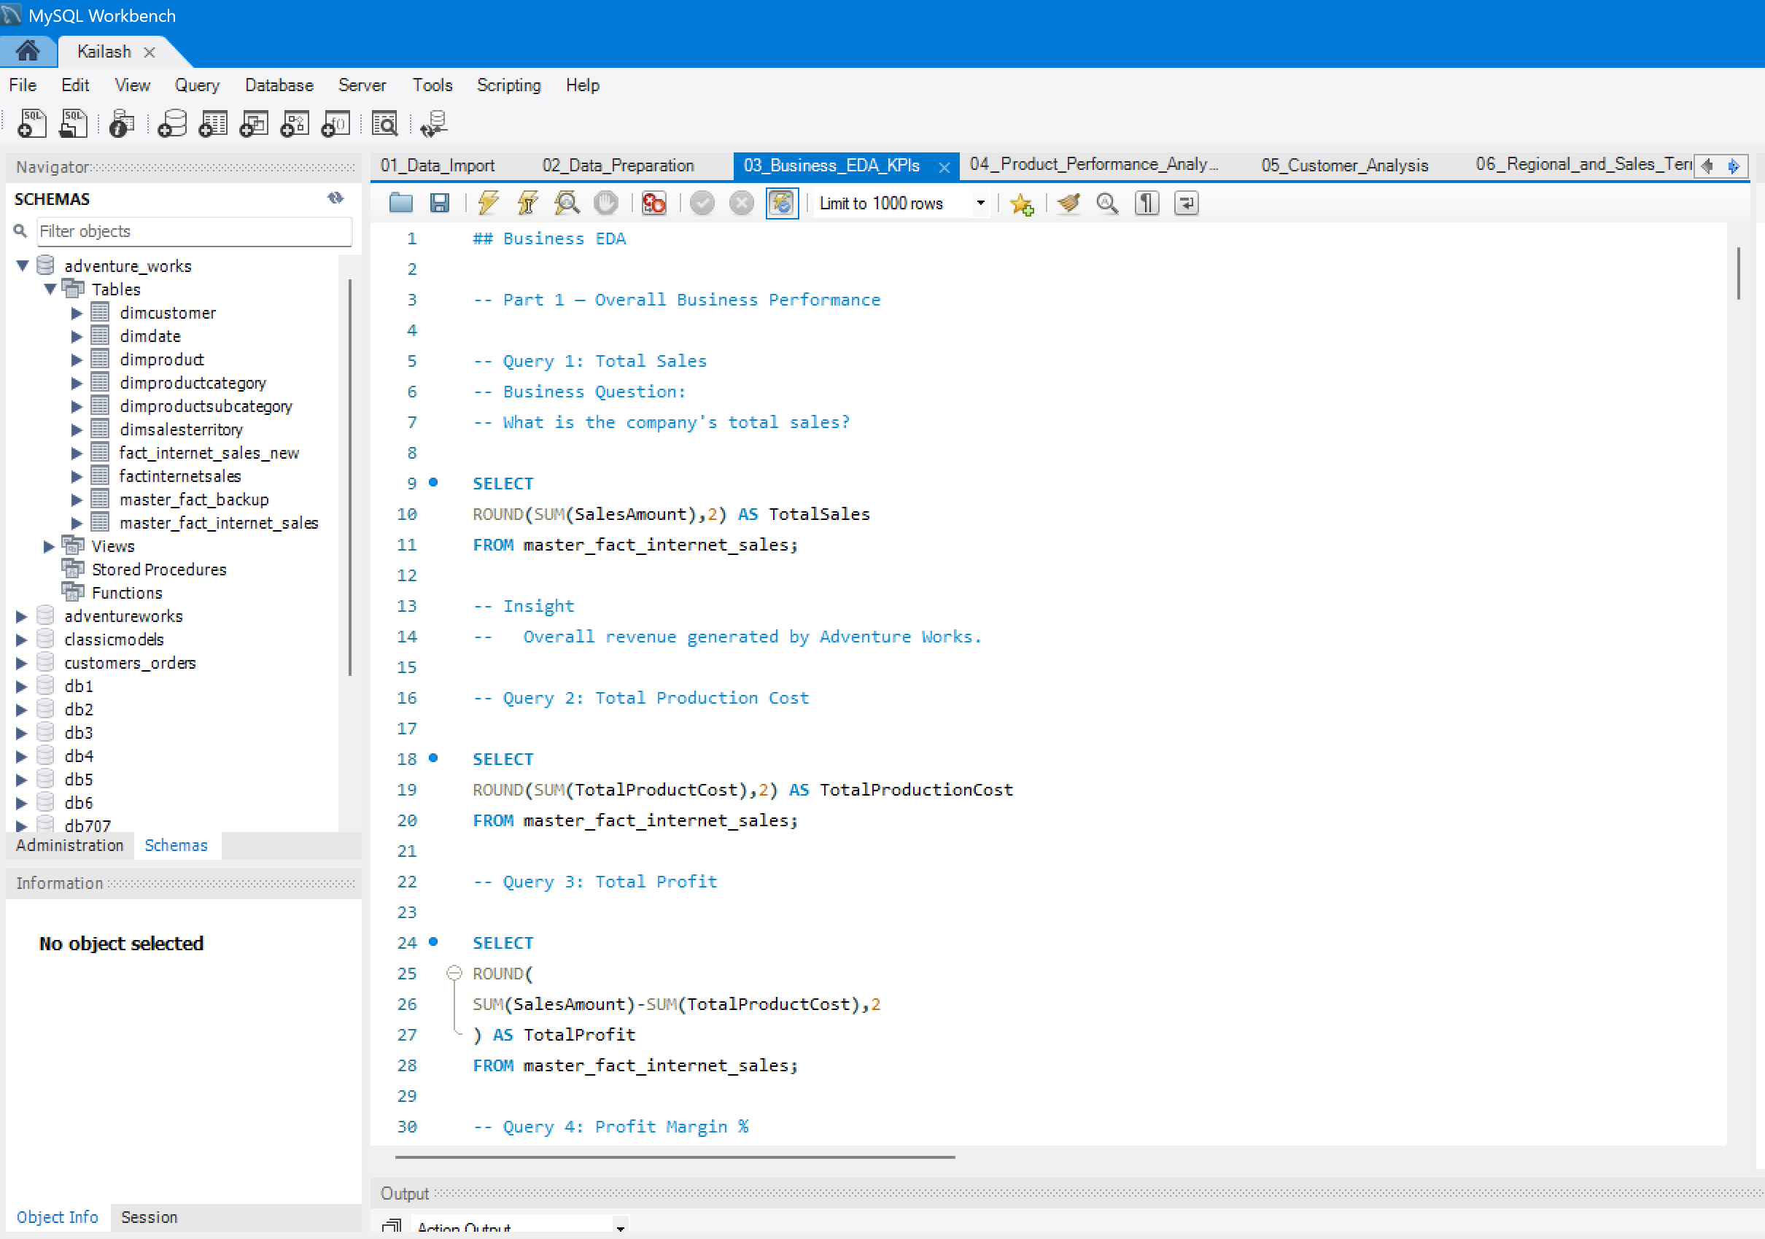

Slide 13
MySQL Business Insights
Insights Generated Using SQL
Executive KPIs
💰 Total Sales
📈 Total Profit
👥 Total Customers
🛒 Total Orders
📦 Total Quantity
Analytical Reports
Sales by Country
Sales by Territory
Product Category Analysis
Top Customers
Monthly Sales Trend
Profit by Region
Business Value
Faster reporting
Better data quality
Reliable source for dashboards
Foundation for BI analysis

Slide 14

Microsoft Excel Analytics

Slide 15
Microsoft Excel Data Analysis Workflow
Workflow
MySQL Export
Import into Excel
Data Validation
Calculated Columns
Pivot Tables
Charts
Interactive Dashboard
Excel Features Used
XLOOKUP / VLOOKUP
IF Functions
SUMIFS
Pivot Tables
Pivot Charts
Slicers
Conditional Formatting
Combo Charts

Slide 16
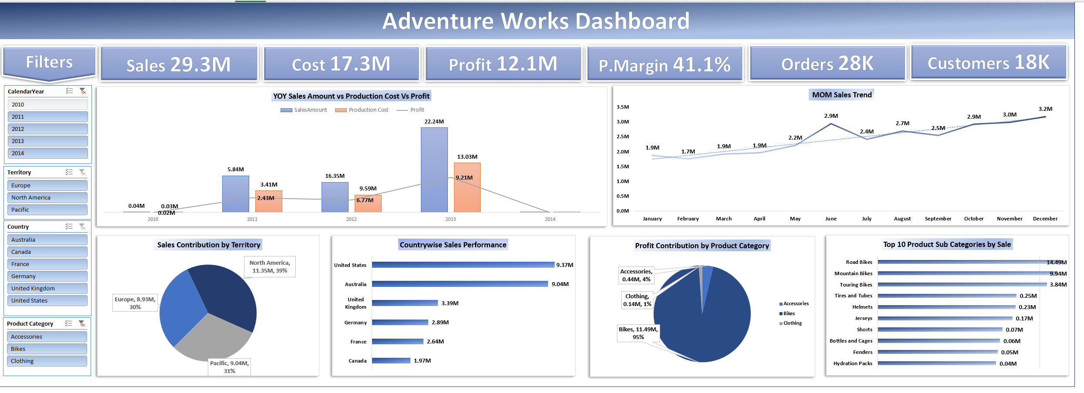

Slide 17
Excel Dashboard
Executive Dashboard in Microsoft Excel
Key KPIs Displayed
Total Sales: 29.36M
Production Cost: 17.28M
Total Profit: 12.08M
Profit Margin: 41.1%
Orders: 28K
Customers: 18K
Key Visuals
Year-over-Year Sales vs Production Cost vs Profit
Month-over-Month Sales Trend
Sales by Territory
Country-wise Sales Performance
Product Category Contribution
Top 10 Product Subcategories
Dashboard Features
Interactive slicers
Dynamic KPI cards
Combination charts
Executive summary layout

Slide 18
Excel Outcomes & Transition
Key Outcomes from Excel Analysis
Achievements
Why Move to Power BI?
✔ Cleaned and validated data
✔ Built calculated metrics
✔ Created dynamic KPI cards
✔ Developed interactive dashboard
✔ Performed trend analysis
✔ Generated executive reports
Although Excel is powerful, Power BI offers:
Better scalability
Interactive drill-through
Advanced DAX calculations
Automated refresh
Richer visualizations
Enterprise-level reporting

Slide 19
Power BI Business Intelligence

Slide 20
Power BI Data Modelling & ETL Process
Transform cleaned data into an interactive Business Intelligence solution for executive decision-making.
Components Used
Power Query
Data Import
Data Transformation
Column Formatting
Data Validation
Data Model
Star Schema
Relationships
Cardinality
Cross Filtering
Components Used
DAX Measures
Total Sales
Total Profit
Profit Margin
Orders
Customers
Quantity
Average Order Value
Data Flow
MySQL Database
Power Query Editor
Data Cleaning
Star Schema Model
DAX Measures
Interactive Dashboards
Business Insights

Slide 21
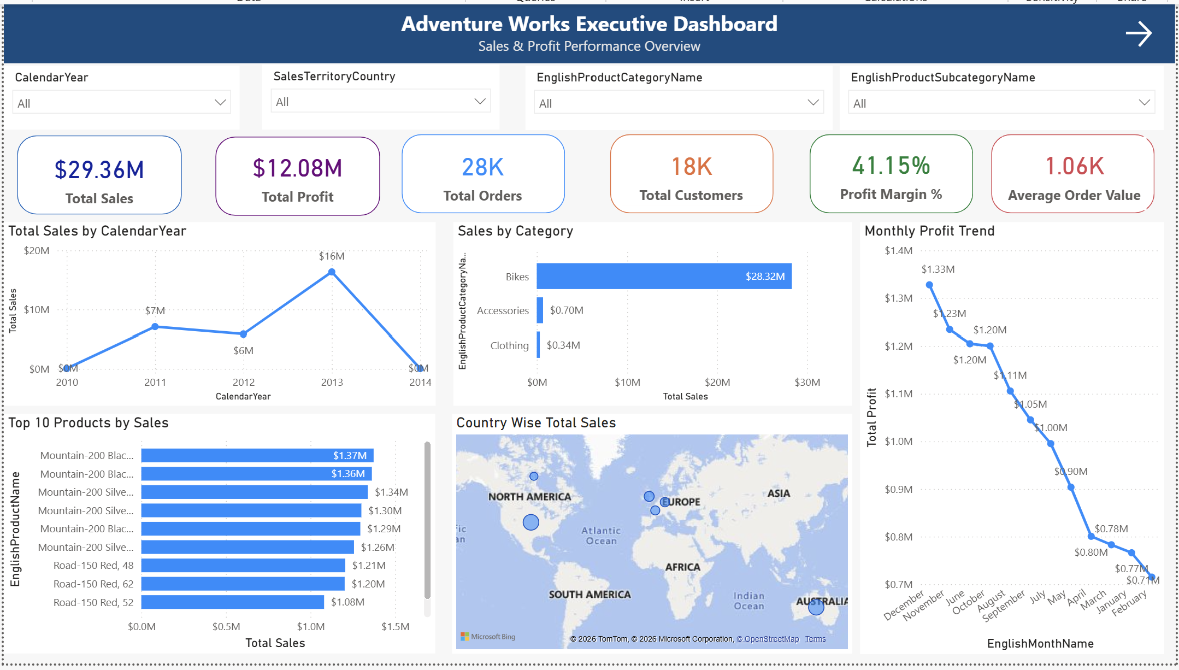

Slide 22
Power BI Executive Dashboard
Executive Dashboard
Executive KPIs
💰 Total Sales
💵 Total Production Cost
📈 Total Profit
📊 Profit Margin
📦 Total Quantity
👥 Customers
🛒 Orders
Dashboard Components
KPI Cards
Monthly Sales Trend
Sales by Country
Sales by Category
Sales by Subcategory
Sales by Occupation
Slicers for Year, Country, Product
Business Value
Provides executives with a single-page overview of business performance.

Slide 23
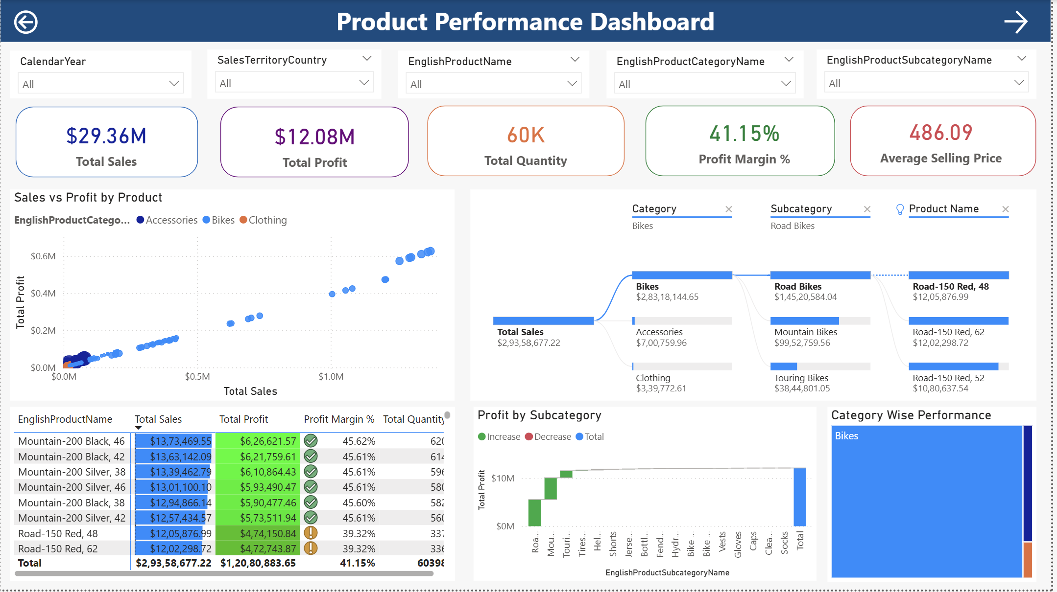

Slide 24
Product Performance Dashboard
Product Performance Analysis
KPIs
Top Performing Products
Revenue by Product
Profit by Product
Category Analysis
Subcategory Analysis
Business Questions Answered
✔ Which products generate maximum revenue?
✔ Which products generate highest profit?
✔ Which categories need improvement?
✔ Which products contribute least?
Management Benefits
Inventory Planning
Demand Forecasting
Product Strategy
Pricing Decisions

Slide 25
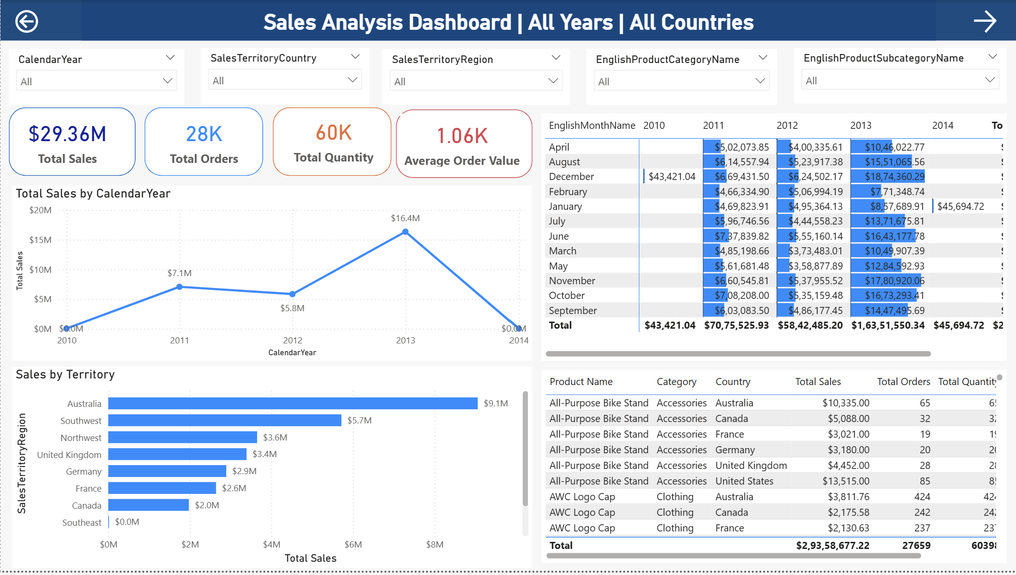

Slide 26
Sales Analysis Dashboard
Sales Trend Analysis
Dashboard Highlights
Monthly Trend
Yearly Trend
Seasonality
Category Trend
Profit Trend
Sales Growth
Business Questions
How are sales changing over time?
Which months perform best?
Which categories drive growth?
How is profit trending?
Benefits
Sales Planning
Demand Forecasting
Budget Allocation
Performance Monitoring

Slide 27
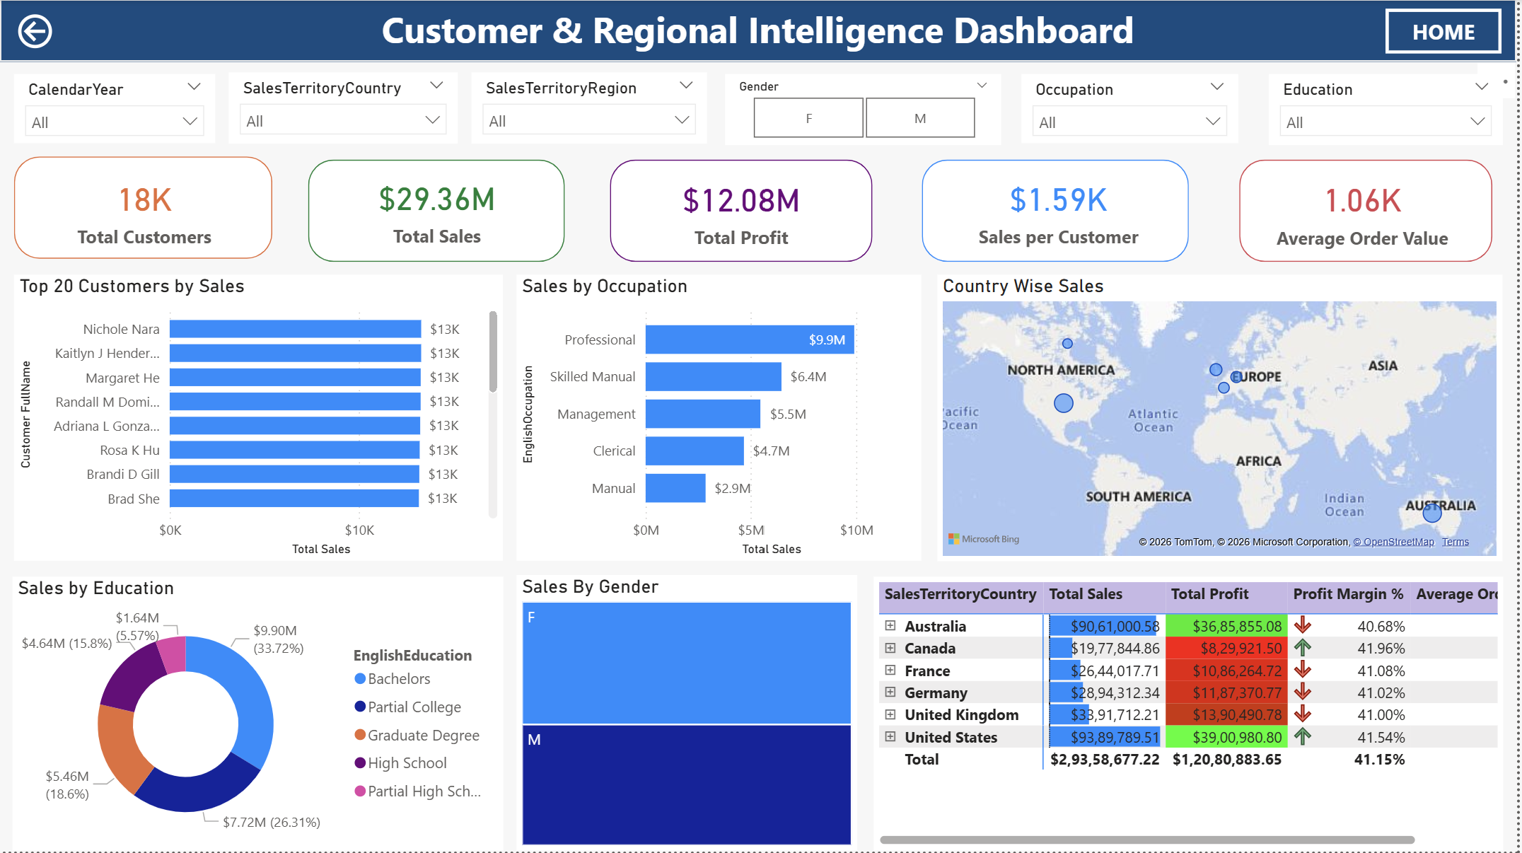

Slide 28
Customer & Regional Intelligence Dashboard
Customer & Regional Intelligence
Customer Analysis
Top Customers
Occupation
Income Level
Gender
Age Group
Regional Analysis
Country
Sales Territory
Region
Revenue
Profit
Business Insights
✔ Best-performing countries
✔ Customer segmentation
✔ Regional profitability
✔ Sales distribution

Slide 29
DAX Measures & Business KPIs
DAX Measures Used
Core Measures
Total Sales
Total Profit
Total Orders
Profit Margin %
Average Order Value
Sales Growth
Customer Count
Why DAX?
Dynamic Calculations
Interactive KPIs
Fast Aggregations
Filter Context
Time Intelligence
Reusable Measures
KPI Cards
Total Sales
Profit
Margin
Orders
Customers
Quantity

Slide 30
Tableau Business Analytics

Slide 31
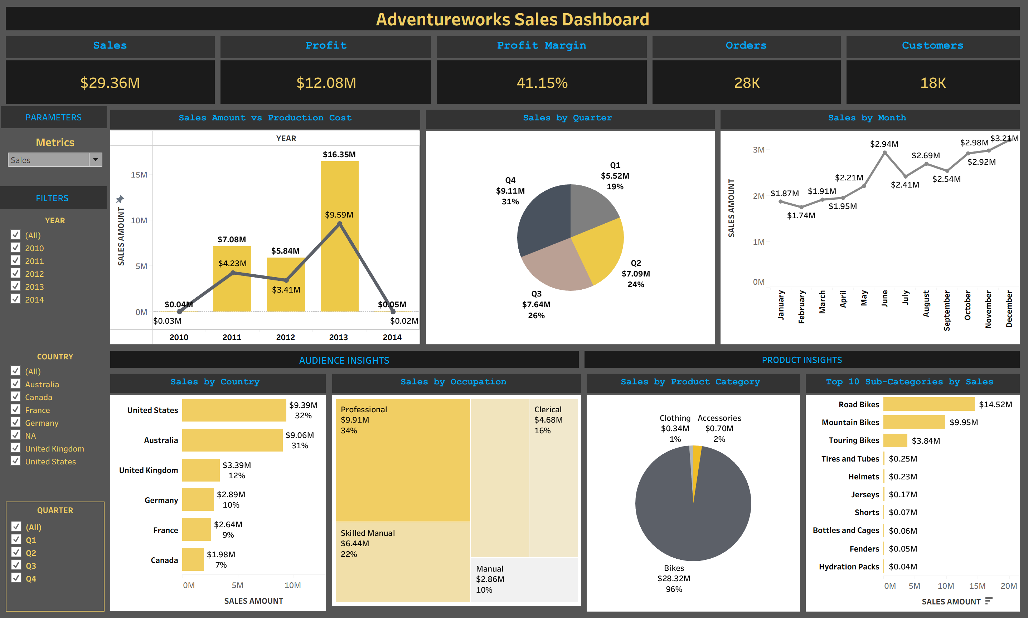

Slide 32
Tableau Business Analytics
Interactive Dashboard in Tableau
Dashboard Components
KPI Cards
Sales Trend
Regional Analysis
Category Performance
Customer Insights
Filters
Parameters
Interactive Features
✔ Dynamic Filters
✔ Drill-down Analysis
✔ Parameters
✔ Interactive Charts
✔ Tooltips
Business Value
Provides an alternative interactive visualization platform with strong exploratory analytics capabilities.

Slide 33
Power BI vs Tableau Comparison
Project Experience
Power BI
Strong data modelling
Powerful DAX
Excellent KPI reporting
Enterprise dashboards
Tableau
Superior visual storytelling
Excellent interactivity
Rich visualization library
Strong exploratory analysis
Feature | Power BI | Tableau
Data Modeling | ⭐⭐⭐⭐⭐ | ⭐⭐⭐
DAX Calculations | ⭐⭐⭐⭐⭐ | ⭐⭐
Dashboard Design | ⭐⭐⭐⭐⭐ | ⭐⭐⭐⭐⭐
Data Visualization | ⭐⭐⭐⭐ | ⭐⭐⭐⭐⭐
Ease of Use | ⭐⭐⭐⭐ | ⭐⭐⭐⭐
Enterprise Reporting | ⭐⭐⭐⭐⭐ | ⭐⭐⭐⭐
Cost Effectiveness | ⭐⭐⭐⭐⭐ | ⭐⭐⭐

Slide 34

Business Insights, Recommendations & Conclusion

Slide 35
Executive Business Performance Summary
KPI Cards
Executive Summary
KPI | Value
💰 Total Sales | $29.36M
💵 Total Production Cost | $17.28M
📈 Total Profit | $12.08M
📊 Profit Margin | 41.15%
👥 Customers | 18K
🛒 Orders | 28K
📦 Quantity Sold | 60K
💲 Average Order Value | $1.06K
Strong overall sales performance
Healthy profit margin
Consistent customer growth
Global sales presence
High-performing product portfolio

Slide 36
Key Business Insights
Business Insights Generated
Sales Insights
📈 Sales exceeded $29 million.
Profitability
💰 Profit margin remained above 41%, indicating strong operational efficiency.
Product Insights
🏆 Bikes contribute the highest share of revenue.
Accessories offer additional cross-selling opportunities.
Regional Insights
🌍 Australia and the United States are the strongest performing markets.
Customer Insights
👥 Professional customers generate the highest sales.
Time Analysis
📅 2013 was the best-performing year.

Slide 37
Business Recommendations
Recommendation 1
Increase inventory for high-performing bicycle products.
Recommendation 2
Expand marketing campaigns in Australia and North America.
Recommendation 3
Offer loyalty programs for high-value customers.
Recommendation 4
Promote premium products to increase average order value.
Recommendation 5
Use demand forecasting to improve inventory planning.
Recommendation 6
Monitor low-performing categories and optimize pricing strategies.
Expected Business Benefits
Increased revenue
Improved customer retention
Better inventory management
Higher profitability
More effective decision-making

Slide 38
Challenges & Solutions
Challenges Faced During the Project
Challenge | Solution
Importing large datasets | Used MySQL for structured storage
Data inconsistencies | Data cleaning in Excel & Power Query
Relationship management | Designed Star Schema
Complex calculations | Implemented DAX measures
Dashboard performance | Optimized data model
Interactive reporting | Used Power BI and Tableau

Slide 39
Technical Skills Applied
Skills Demonstrated
Database
MySQL
SQL
Relational Database Design
Star Schema
Data Analysis
Microsoft Excel
Pivot Tables
Advanced Formulas
Data Cleaning
Business Intelligence
Power BI
Power Query
DAX
Data Modeling
Interactive Dashboards
Visualization
Tableau
Dashboard Design
Storytelling
KPI Reporting
Soft Skills
Business Analysis
Problem Solving
Data Storytelling
Presentation Skills

Slide 40
Project Achievements
Successfully Completed
Deliverables
✔ Database Design
✔ Data Integration
✔ Data Cleaning
✔ KPI Development
✔ Interactive Dashboards
✔ SQL Analytics
✔ Business Reporting
✔ Data Visualization
✔ Executive Insights
MySQL Database
Excel Dashboard
Power BI Reports
Tableau Dashboard
Project Documentation
Final Presentation

Slide 41
Future Scope
Predictive Analytics
Forecast future sales using machine learning.
Customer Segmentation
Apply clustering techniques to identify customer groups.
Inventory Optimization
Use predictive models for stock planning.
Real-Time Dashboards
Connect dashboards to live databases for real-time reporting.
Cloud Deployment
Deploy reports using cloud platforms such as Microsoft Fabric, Azure, or Power BI Service.
AI Integration
Use AI-powered insights for anomaly detection and trend forecasting.

Slide 42
Conclusion
Project Conclusion
Summary
This project demonstrates the complete Business Intelligence lifecycle by integrating:
MySQL for data storage and SQL analysis
Excel for data preparation and KPI reporting
Power BI for interactive dashboards and business analytics
Tableau for advanced visual storytelling
Key Outcome
The solution transforms raw transactional data into meaningful business insights, enabling faster, data-driven decision-making.

Slide 43

Thank You
Kailash Singh Rawat
7877571308
kailashsingh2203@gmail.com
https://github.com/kailash4454

